Slide 1

IRIS FLOWER CLASSIFICATION
Classifies the truth.
A project by :
Abhishek B Wagh
DY Patil University, Ambi.

Slide 2
INTRODUCTION
The field of data science has revolutionized numerous industries by leveraging advanced algorithms and techniques to extract meaningful insights from vast amounts of data. One such application is the classification of Iris flowers, a classic problem in the domain of machine learning.
The Iris flower dataset, introduced by the statistician Ronald Fisher in 1936, is a popular benchmark for beginners in the field of machine learning. The primary goal of Iris flower classification is to build a model that can accurately predict the species of an Iris flower based on its physical characteristics. This task involves exploring the dataset, preparing the data, selecting appropriate features, and training a classification algorithm to make accurate predictions.

Slide 3
METHODOLOGY
The classification process typically involves several steps.
the dataset is loaded into a suitable programming environment or tool, such as Python and its data science libraries (e.g., NumPy, Pandas, scikit-learn).
Exploratory data analysis (EDA) techniques are then employed to understand the structure and characteristics of the dataset.
Data preprocessing techniques are applied to clean, normalize, and transform the data.
Once the data is prepared, various classification algorithms can be employed, such as logistic regression, decision trees, random forests, or support vector machines.
Furthermore, data visualization techniques, including scatter plots, histograms, and confusion matrices, enable data scientists to gain insights into the model's behavior, interpret the results, and communicate the findings effectively.

Slide 4
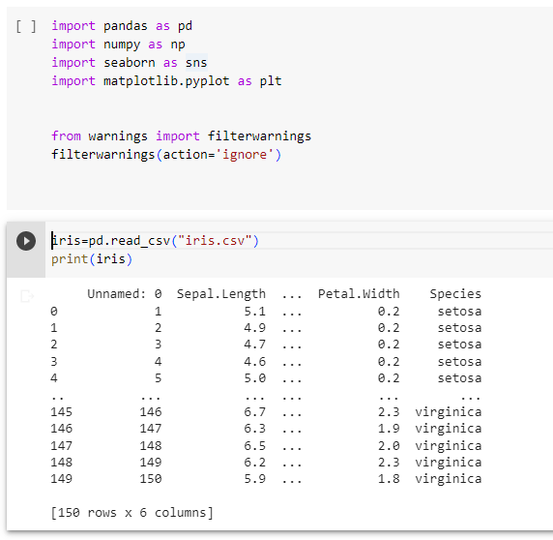
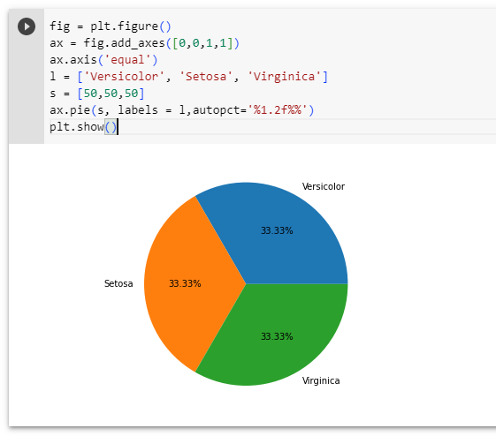
CODE INSIGHTS

Slide 5
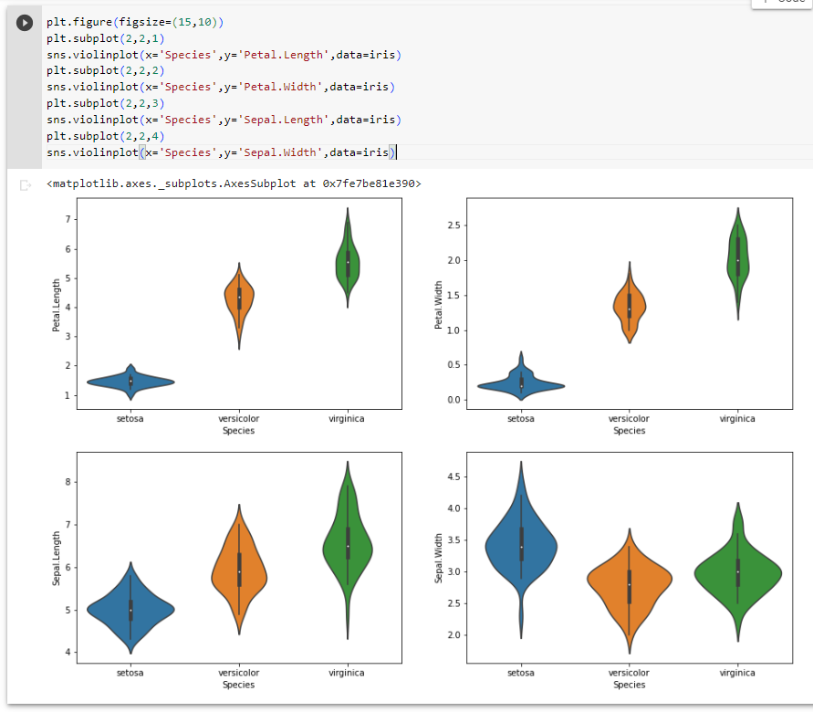
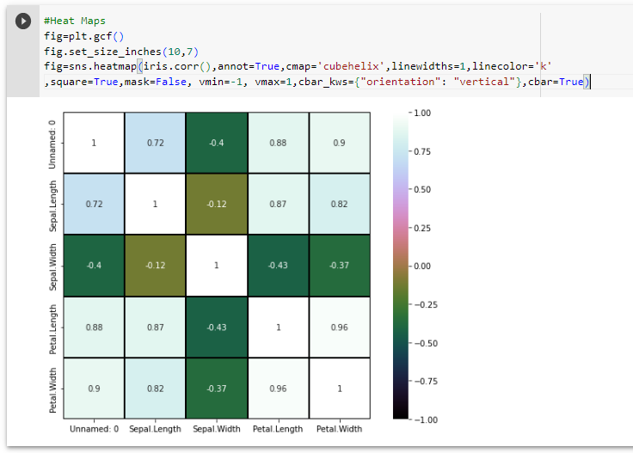
CODE INSIGHTS

Slide 6
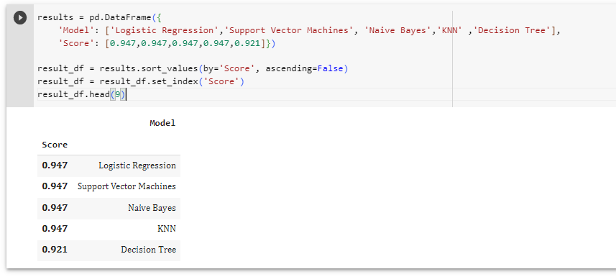
OUTPUT

Slide 7
CONCLUSION
Iris flower classification using data science and machine learning provides an excellent introduction to the world of machine learning and demonstrates the power of data-driven approaches in solving real-world problems. By employing statistical analysis, preprocessing techniques, feature selection, and classification algorithms, data scientists can build models that accurately classify Iris flowers based on their physical attributes. The skills and techniques acquired in this task lay a solid foundation for more complex classification problems and further exploration of the diverse field of data science.

Slide 8
THANK YOU !

